Slide 1
Coding
Asheesh Tiwari

Slide 2
Coding
Goal is to implement the design in best possible manner
Coding affects testing and maintenance
As testing and maintenance costs are high, aim of coding activity should be to write code that reduces them
Hence, goal should not be to reduce coding cost, but testing and maintenance cost, i.e. make the job of tester and maintainer easier

Slide 3
Coding…
Code is read a lot more
Coders themselves read the code many times for debugging, extending etc
Maintainers spend a lot of effort reading and understanding code
Other developers read code when they add to existing code
Hence, code should be written so it is easy to understand and read, not easy to write!

Slide 4
Coding…
Having clear goal for coding will help achieve them
Weinberg experiment showed that coders achieve the goal they set
Diff coders were given the same problem
But different objectives were given to diff programmers – minimize effort, min size, min memory, maximize clarity, max output clarity
Final programs for diff programmers generally satisfied the criteria given to them

Slide 5
Weinberg experiment..
 | Resulting Rank (1=best) O1 o2 o3 o4 o5
Minimize Effort (o1) Minimize prog size (o2) Minimize memory (o3) Maximize code clarity (o4) Maximize output clarity (o5) | 1 4 4 5 3 2-3 1 2 3 5 5 2 1 4 4 4 3 3 2 2 2-3 5 5 1 1

Slide 6
Programming Principles and Guidelines
The main task before a programmer is to write quality code with few bugs in it.
The additional constraint is to write code quickly. Writing solid code is a skill that can only be acquired by practice.
However, based on experience, some general rules and guidelines can be given for the programmer.
Good programming (producing correct and simple programs) is a practice independent of the target programming language, although well-structured programming languages make the programmer's job simpler.

Slide 7
1. Common Coding Errors
Software errors are a reality that all programmers have to deal with.
Much of effort in developing software goes in identifying and removing bugs. There are various practices that can reduce the occurrence of bugs, but regardless of the tools or methods we use, bugs are going to occur in programs.
Though errors can occur in a wide variety of ways, some types of errors are found more commonly. Here we give a list of some of the commonly occurring bugs.

Slide 8
1. Common Coding Errors…
Memory Leaks: A memory leak is a situation where the memory is allocated to the program which is not freed subsequently.
This error is a common source of software failures which occurs frequently in the languages which do not have automatic garbage collection (like C, C++).
A software system with memory leaks keeps consuming memory, till at some point of time the program may come to an exceptional halt because of the lack of free memory.

Slide 9
1. Common Coding Errors…
Freeing an Already Freed Resource: In general, in programs, resources are first allocated and then freed. For example, memory is first allocated and then deallocated. This error occurs when the programmer tries to free the already freed resource. The impact of this common error can be catastrophic.

Slide 10
1. Common Coding Errors…
NULL Dereferencing: This error occurs when we try to access the contents of a location that points to NULL.

Slide 11
1. Common Coding Errors…
Lack of Unique Addresses: Aliasing creates many problems, and among them is violation of unique addresses when we expect different addresses.

Slide 12
1. Common Coding Errors…
Synchronization Errors: In a parallel program, where there are multiple threads possibly accessing some common resources, then synchronization errors are possible.
These errors are very difficult to find as they don't manifest easily. But when they do manifest, they can cause serious damage to the system.
There are different categories of synchronization errors, some of which are:
Deadlocks
Race conditions
Inconsistent synchronization

Slide 13
1. Common Coding Errors…
Array Index Out of Bounds: Array index often goes out of bounds, leading to exceptions. Care needs to be taken to see that the array index values are not negative and do not exceed their bounds.
Arithmetic exceptions: These include errors like divide by zero and floating point exceptions. The result of these may vary from getting unexpected results to termination of the program.
Off by One: This is one of the most common errors which can be caused in many ways. For example, starting at 1 when we should start at 0 or vice versa, writing <= N instead of < N or vice versa, and so on.

Slide 14
Coding Process
Coding starts when specs for modules from design is available
Usually modules are assigned to programmers for coding
In top-down development, top level modules are developed first; in bottom-up lower levels modules
For coding, developers use different processes; we discuss some here

Slide 15
1. An Incremental Coding Process
Basic process: Write code for the module, unit test it, fix the bugs
It is better to do this incrementally – write code for part of functionality, then test it and fix it, then proceed
I.e. code is built code for a module incrementally

Slide 16
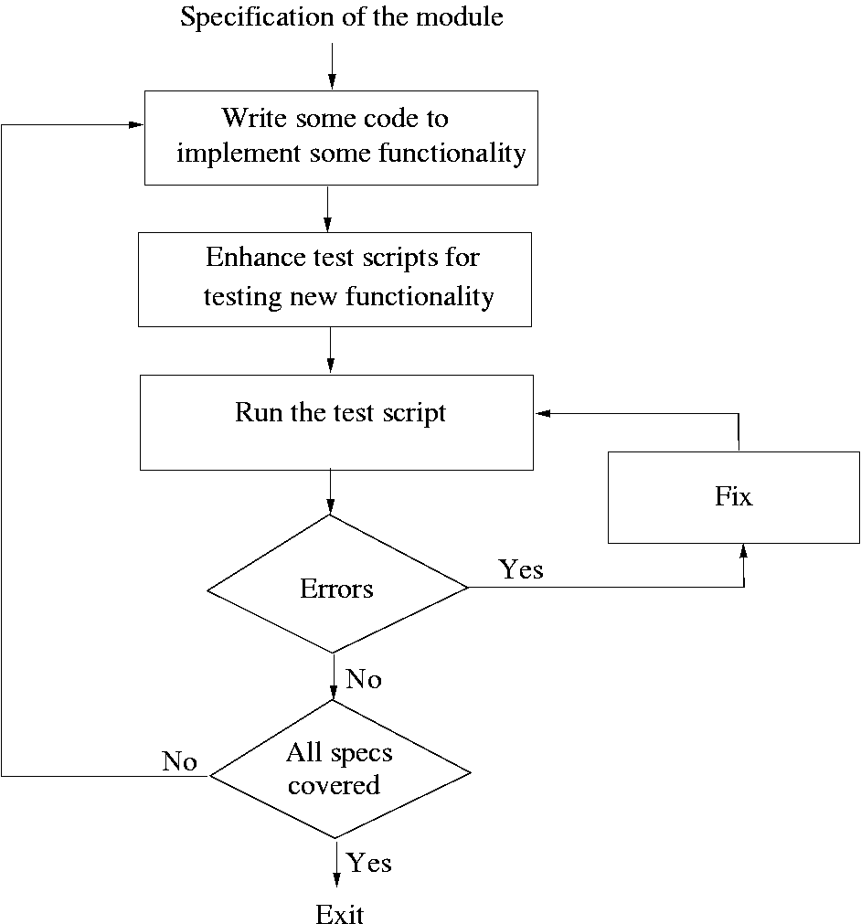

Slide 17
2. Test Driven Development
This coding process changes the order of activities in coding
In TDD, programmer first writes the test scripts and then writes the code to pass the test cases in the script
This is done incrementally
Is a relatively new approach, and is a part of the extreme programming (XP)

Slide 18
2. TDD…
In TDD, you write just enough code to pass the test
I.e. code is always in sync with the tests and gets tested by the test cases
Not true in code first approach, as test cases may only test part of functionality
Responsibility to ensure that all functionality is there is on test case design, not coding
Help ensure that all code is testable

Slide 19
2. TDD…
Focus shifts to how code will be used as test cases are written first
Helps validate user interfaces specified in the design
Focuses on usage of code
Functionality prioritization happens naturally
Has possibility that special cases for which test cases are not possible get left out
Code improvement through refactoring will be needed to avoid getting a messy code

Slide 20
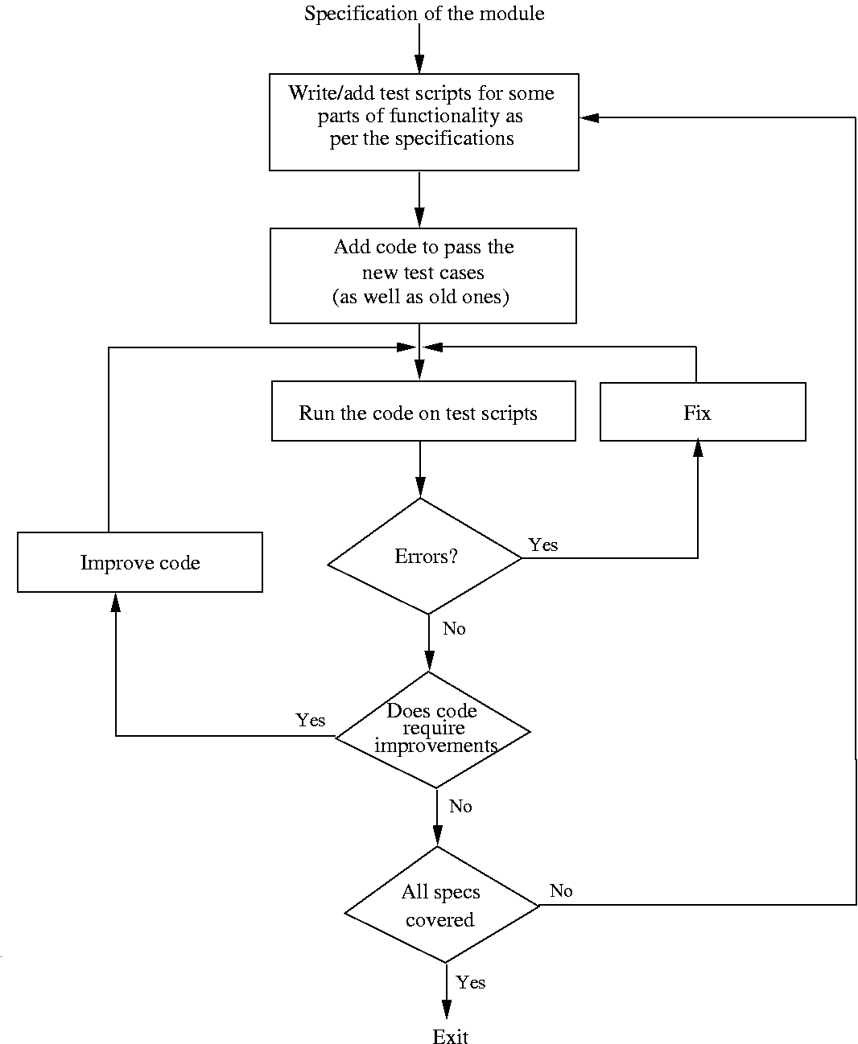

Slide 21
3. Pair Programming
Also a coding process that has been proposed as key practice in XP
Code is written by pair of programmers rather than individuals
The pair together design algorithms, data structures, strategies, etc.
One person types the code, the other actively reviews what is being typed
Errors are pointed out and together solutions are formulated
Roles are reversed periodically

Slide 22
3. Pair Programming…
PP has continuous code review, and reviews are known to be effective
Better designs of algos/DS/logic/…
Special conditions are likely to be dealt with better and not forgotten
It may, however, result in loss of productivity
Ownership and accountability issues are also there
Effectiveness is not yet fully known

Slide 23
4. Source Code Control and Built
Source code control is an essential step programmers have to do
Generally tools like CVS, VSS are used
A tool consists of repository, which is a controlled directory structure
The repository is the official source for all the code files
System build is done from the files in the repository only
Tool typically provides many commands to programmers

Slide 24
4. Source code control…
Get a local copy (Checkout a file): by this a programmer gets a local copy that can be modified. cvs checkout < module >
Make changes to file (Checkin a file): changed files are uploaded in the repository and change is then available to all. cvs commit < file >
Update a local copy: cvs update command
Get Reports: Source control tools provide a host of commands to provide different reports on the evolution of the files.
Tools maintain complete change history and all older versions can be recovered
Source code control is an essential tool for developing large projects and for coordination

Slide 25
Verification
Code has to be verified before it can be used by others
Here we discuss only verification of code written by a programmer (system verification is discussed in testing)
There are many different techniques; key ones – unit testing, inspection, and program checking
Program checking can also be used at the system level

Slide 26
1. Code Inspections
The inspection process can be applied to code with great effectiveness
Inspections held when code has compiled and a few tests passed
Usually static tools are also applied before inspections
Inspection team focuses on finding defects and bugs in code
Checklists are generally used to focus the attention on defects

Slide 27
1. Code Inspections…
Some items in a checklist are
Do all pointers point to something
Are all vars and pointers initialized
Are all array indexes within bounds
Will all loops always terminate
Any security flaws
Is input data being checked
Obvious inefficiencies

Slide 28
1. Code inspections…
Are very effective and are widely used in industry (many require all critical code segments to be inspected)
Is also expensive; for non critical code one person inspection may be used
Code reading is self inspection
A structured approach where code is read inside-out
Is also very effective
Code reading is sometimes called desk review

Slide 29
Metrics
Traditionally, work on metrics has focused on the final product, namely the code.
In a sense, all metrics for intermediate products of requirements and design are basically used to ensure that the final product has a high quality and the productivity of the project stays high.
For the code, the most commonly used metrics are size, complexity, and reliability.

Slide 30
Size Metrics
Size of a product is a simple measure, which can be easy to calculate.
Reasons of importance of Size Metric:
The main reason for interest in size measures is that size is the major factor that affects the cost of a project.
It is the relationship of size with the cost and quality that makes size an important metric. It is also used to measure productivity during the project (e.g., KLOC per person month).
Final quality delivered by a process is also frequently normalized with respect to size (number of defects per KLOC).
The most common measure of size is delivered lines of source code, or the number of lines of code (LOC) finally delivered.
The trouble with LOC is that the number of lines of code for a project depends heavily on the language used.

Slide 31
Size Metrics
Halstead has proposed metrics for length and volume of a program based on the number of operators and operands. In a program we define the following measurable quantities:
Halstead’s Volume
n1: no of distinct operators
n2: no of distinct operands
N1: total occurrences of operators
N2: Total occurrences of operands
Vocabulary, n = n1 + n2
Length, N = N1 + N2
Volume, V = N log₂(n)

Slide 32
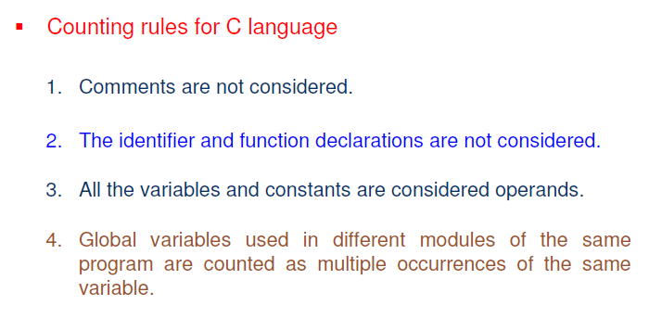
Size Metrics

Slide 33
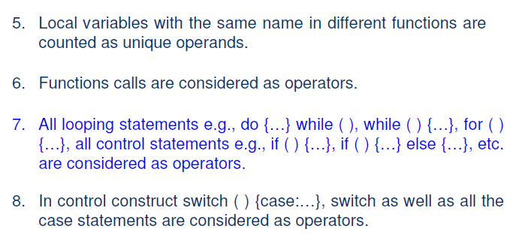
Size Metrics

Slide 34
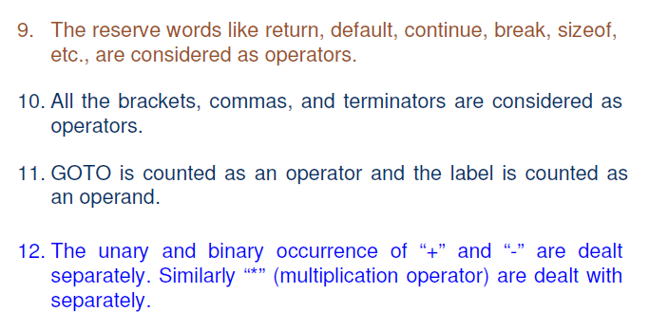
Size Metrics

Slide 35
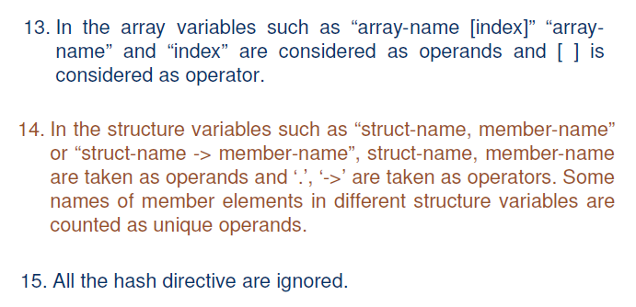
Size Metrics

Slide 36
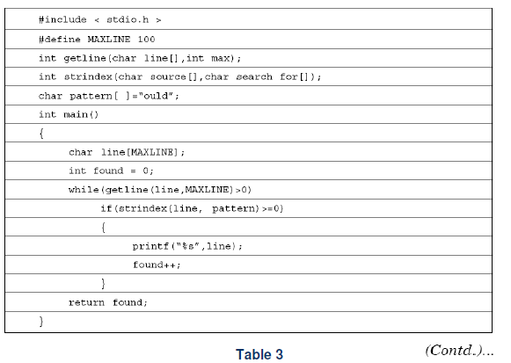
Size Metrics

Slide 37
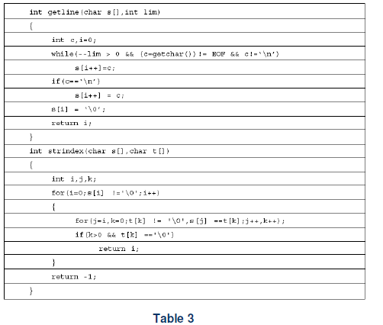
Size Metrics

Slide 38
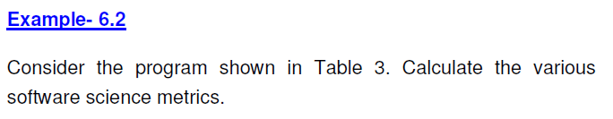
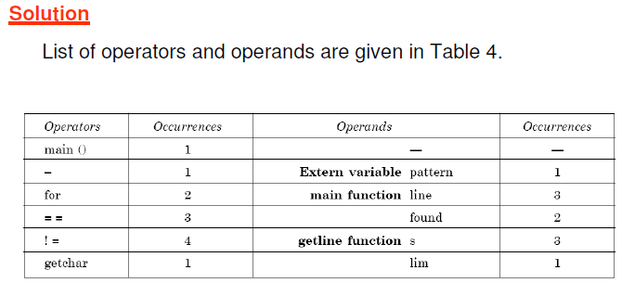
Size Metrics

Slide 39
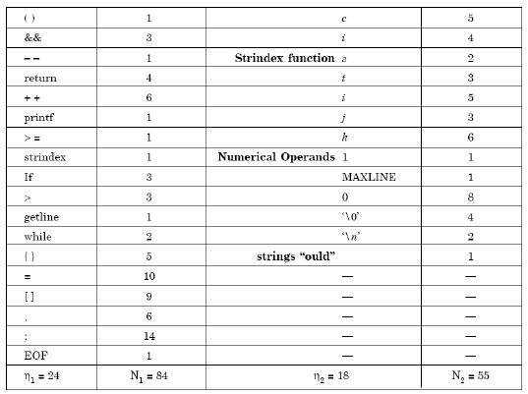
Size Metrics

Slide 40
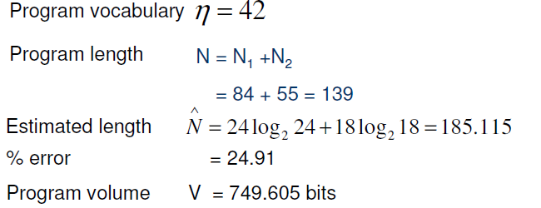
Size Metrics

Slide 41
Complexity Metrics
The productivity, if measured only in terms of lines of code per unit time, can vary a lot depending on the complexity of the system to be developed.
Clearly, a programmer will produce a lesser amount of code for highly complex system programs, as compared to a simple application program.
Similarly, complexity has great impact on the cost of maintaining a program.
To quantify complexity beyond the fuzzy notion of the ease with which a program can be constructed or comprehended, some metrics to measure the complexity of a program are needed.

Slide 42
Complexity Metrics
Cyclomatic Complexity is perhaps the most widely used measure
Represents the program by its control flow graph with e edges, n nodes, and p parts
Cyclomatic complexity is defined as V(G) = e-n+p
This is same as the number of linearly independent cycles in the graph
And is same as the number of decisions (conditionals) in the program plus one

Slide 43
Cyclomatic complexity example…
{
i=1;
while (i<=n) {
J=1;
while(j <= i) {
If (A[i]<A[j])
Swap(A[i], A[j]);
J=j+1;}
i = i+1;}
}

Slide 44
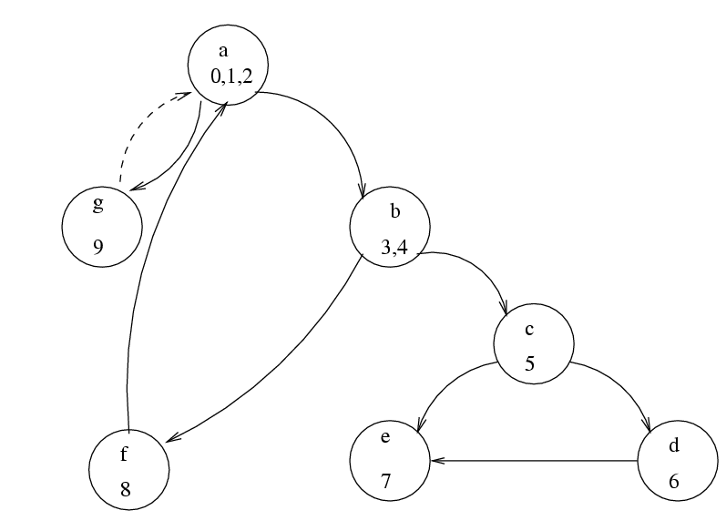
Example…

Slide 45
Example…
V(G) = 10-7+1 = 4
Independent circuits
b c e b
b c d e b
a b f a
a g a
No of decisions is 3 (while, while, if); complexity is 3+1 = 4

Slide 46
Complexity metrics…
Halsteads
N2/n2 is avg times an operand is used
If vars are changed frequently, this is larger
Ease of reading or writing is defined as D = (n1*N2)/(2*n2)
There are others, e.g. live variables, knot count..

Slide 47
Complexity metrics…
The basic use of these is to reduce the complexity of modules
One suggestion is that cyclomatic complexity should be less than 10
Another use is to identify high complexity modules and then see if their logic can be simplified

